Slide 1


HEP NTUA Weekly Report 21/4/2021
George Bakas

Slide 2
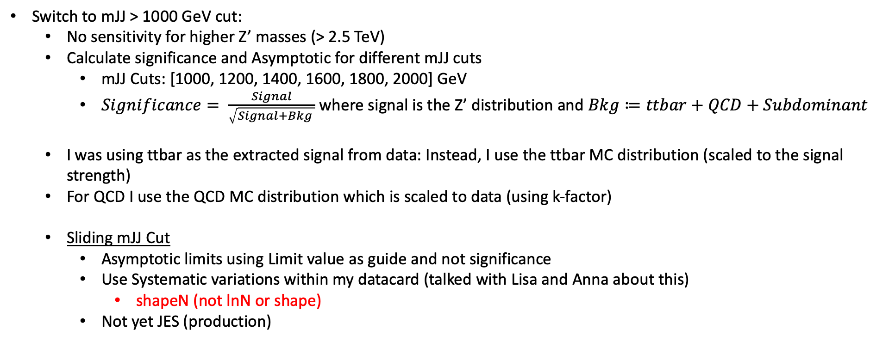
Summary Z’ Analysis
Switch to mJJ > 1000 GeV cut:
No sensitivity for higher Z’ masses (> 2.5 TeV)
Calculate significance and Asymptotic for different mJJ cuts
mJJ Cuts: [1000, 1200, 1400, 1600, 1800, 2000] GeV
$Significance= \frac{Signal}{\sqrt{Signal+Bkg }}$ where signal is the Z’ distribution and $Bkg≔ttbar+QCD+Subdominant$
I was using ttbar as the extracted signal from data: Instead, I use the ttbar MC distribution (scaled to the signal strength)
For QCD I use the QCD MC distribution which is scaled to data (using k-factor)
Sliding mJJ Cut
Asymptotic limits using Limit value as guide and not significance
Use Systematic variations within my datacard (talked with Lisa and Anna about this)
shapeN (not lnN or shape)
Not yet JES (production)

Slide 3
Datacard Summary (example for mJJ > 1600 GeV)
imax * number of bins
jmax * number of processes minus 1
kmax * number of nuisance parameters
----------------------------------------------------------------------------
shapes * SR_C ProcessesFile_1600.root h_chi_$PROCESS h_chi_$PROCESS_$SYSTEMATIC
shapes Zprime SR_C ZprimeFile_2000_20_massCut1600.root h_chi_$PROCESS
shapes data_obs SR_C DataFile_1600.root h_Data
----------------------------------------------------------------------------
bin SR_C
observation -1.0
----------------------------------------------------------------------------
bin SR_C SR_C SR_C SR_C
process Zprime qcd Subdominant ttbar
process 0 1 2 3
rate -1.0 -1.0 -1.0 -1.0
----------------------------------------------------------------------------
yield_ttbar lnN - - - 1.5
yield_qcd lnN - 1.5 - -
yield_Subdominant lnN - - 1.5 -
lumi_13TeV lnN - 1.025 1.025 1.025
scale shapeN - - - 1.0
pdf shapeN - - - 1.0
fsr shapeN - - - 1.0
isr shapeN - - - 1.0
btag shapeN - - - 1.0
* autoMCStats 10 1

Slide 4
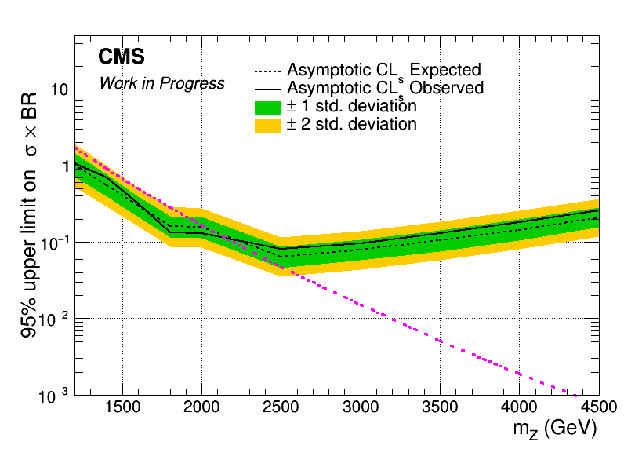
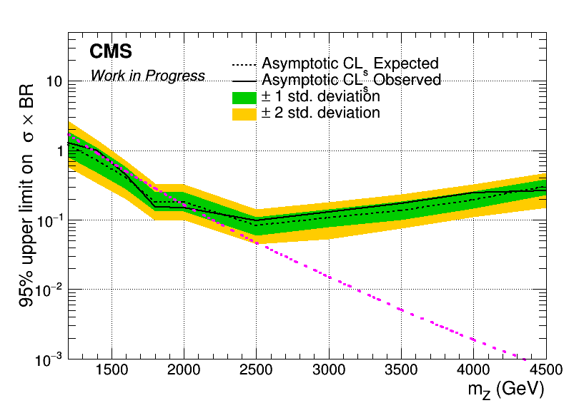
Brazilian Plots (2017 and 2018) with sliding mJJ Cut
Mass Cut Mapping
{"mZ_1200_12":1000, "mZ_1400_14":1200, "mZ_1600_16":1400, "mZ_1800_18":1600, "mZ_2000_20":1600,
"mZ_2500_25":2000, "mZ_3000_30":2000, "mZ_3500_35":2000, "mZ_4000_40":2000, "mZ_4500_45":2000}
2017
2017 with systematics

Slide 5
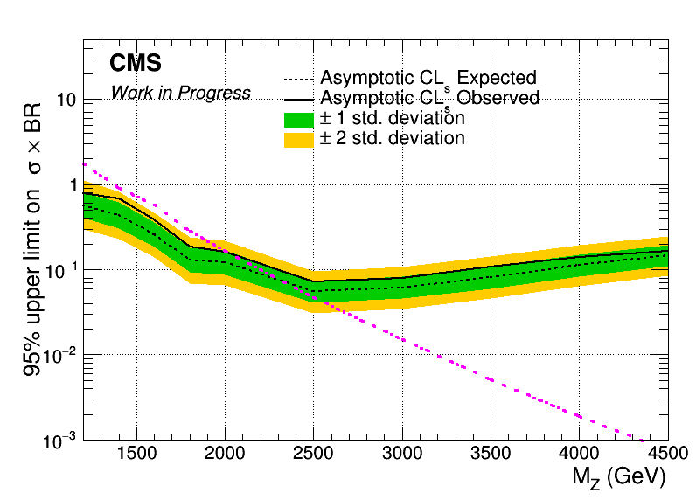
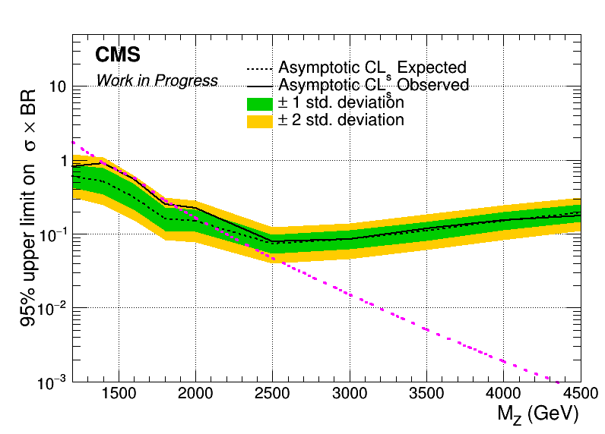
Brazilian Plots (2017 and 2018) with sliding mJJ Cut
Mass Cut Mapping
{"mZ_1200_12":1000, "mZ_1400_14":1200, "mZ_1600_16":1400, "mZ_1800_18":1600, "mZ_2000_20":1600,
"mZ_2500_25":2000, "mZ_3000_30":2000, "mZ_3500_35":2000, "mZ_4000_40":2000, "mZ_4500_45":2000}
2018
2018 with systematics

Slide 6
BACKUP

Slide 7
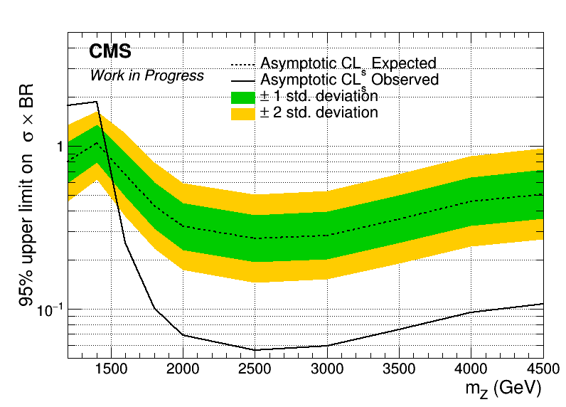
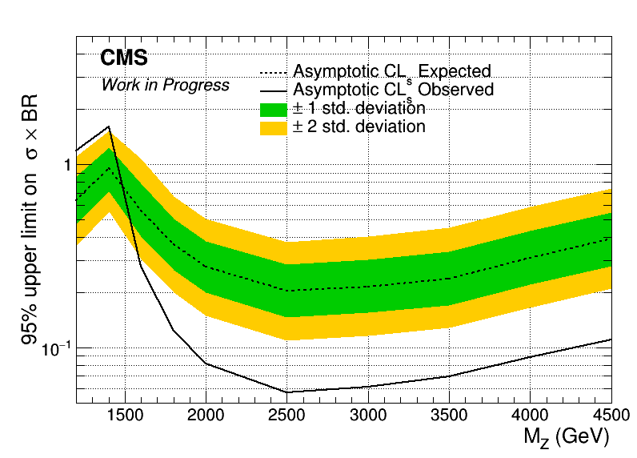
Angular Distributions (Brazilian Plot using data!!!!)
Assymptotic limits for M Z’: 1.2, 1.4, 1.6, 1.8, 2, 2.5, 3, 3.5, 4, 4.5 TeV
Width 1%
2017
2018

Slide 8
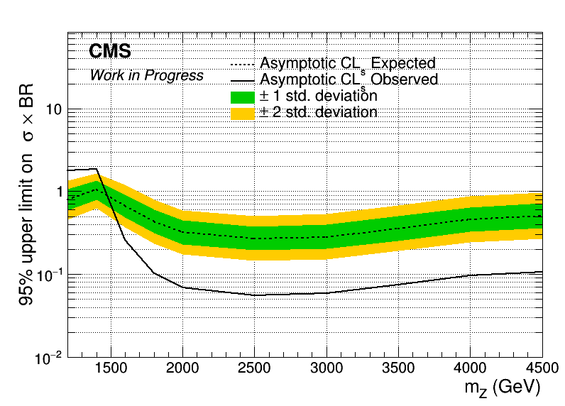
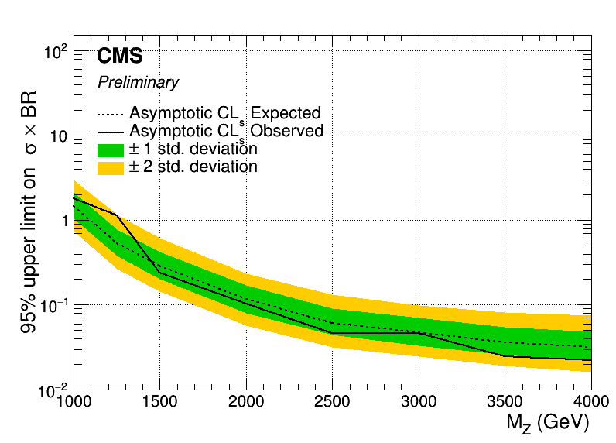
Angular Distributions (Brazilian Plot using extracted signal!!) vs B2G-16-015
Assymptotic limits for M Z’: 1.2, 1.4, 1.6, 1.8, 2, 2.5, 3, 3.5, 4, 4.5 TeV
Width 1%
2017
B2G-16-015

Slide 9
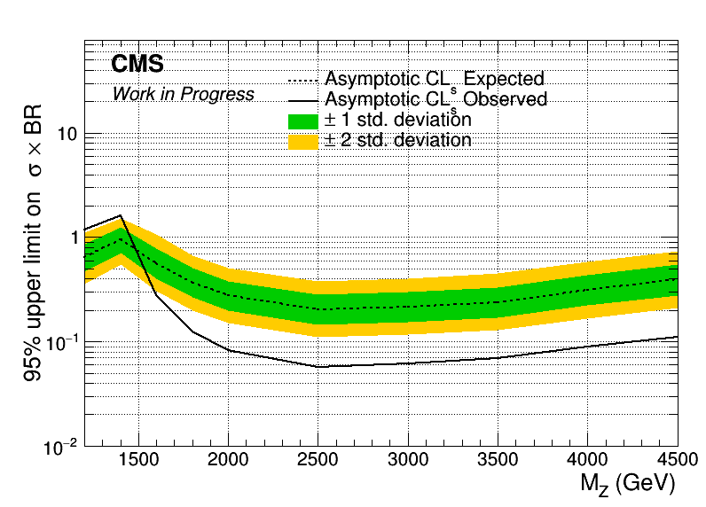
Angular Distributions (Brazilian Plot using extracted signal!!) vs B2G-16-015
Assymptotic limits for M Z’: 1.2, 1.4, 1.6, 1.8, 2, 2.5, 3, 3.5, 4, 4.5 TeV
Width 1%
2018
B2G-16-015

Slide 10
Signal Selection
Control Region Selection
Variables | Selected Cut
pT (both leading jets) | > 400 GeV
Njets | > 1
N leptons | = 0
|eta| (both leading jets) | < 2.4
mJJ | > 1000 GeV
jetMassSoftDrop (only for fit) | (50,300) GeV
Top Tagger | > 0.2, 0, 0.1
B tagging (2 btagged jets) | > Medium WP
Signal Trigger
Variables | Selected Cut
pT (both leading jets) | > 400 GeV
Njets | > 1
N leptons | = 0
|eta| (both leading jets) | < 2.4
mJJ | > 1000 GeV
jetMassSoftDrop (only for fit) | (50,300) GeV
Top Tagger | > 0.2, 0, 0.1
B tagging (0 btagged jets) | < Medium WP
Control Trigger

Slide 11
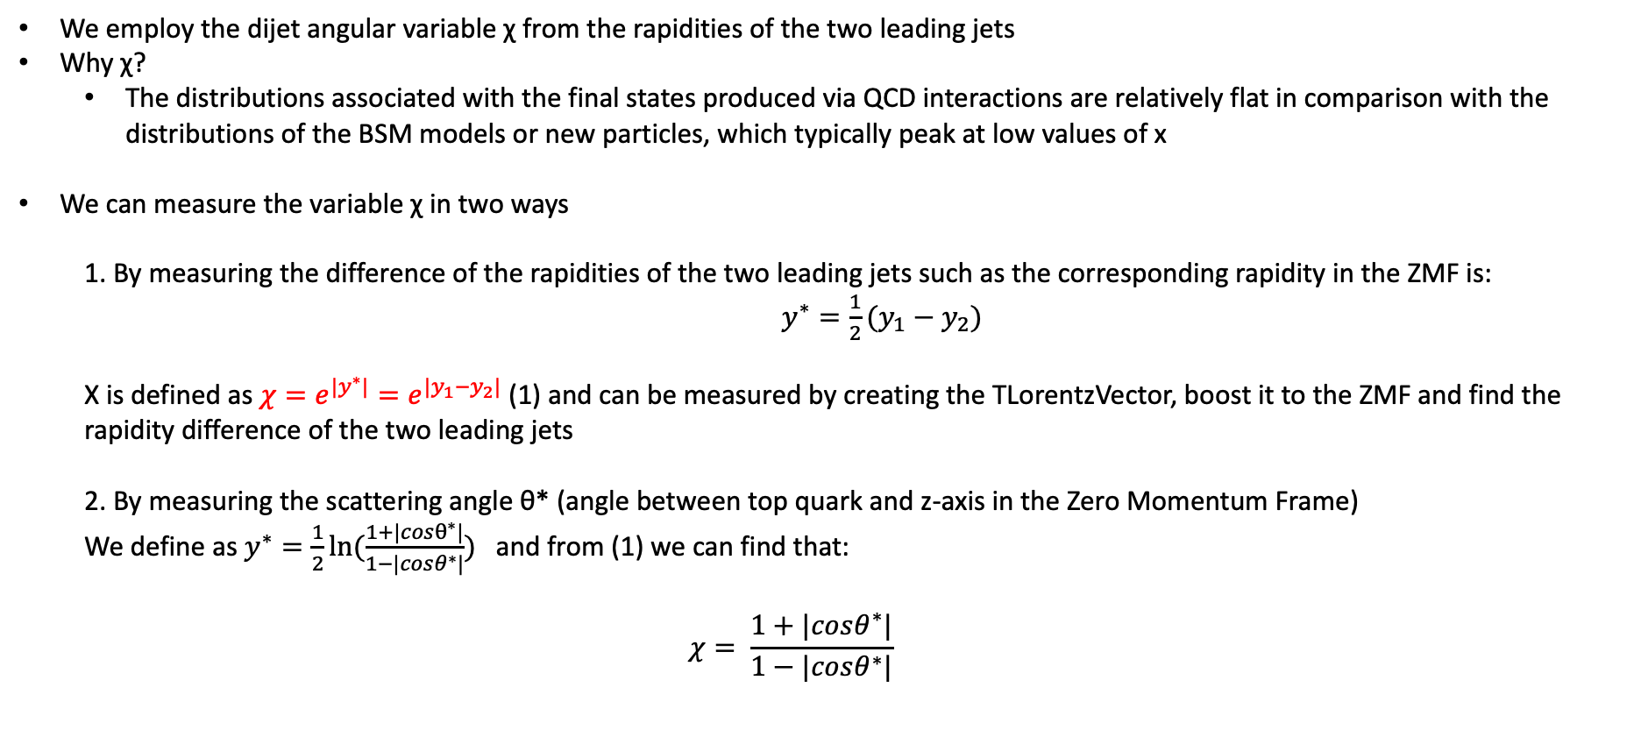
Top Angular Distributions
We employ the dijet angular variable χ from the rapidities of the two leading jets
Why χ?
The distributions associated with the final states produced via QCD interactions are relatively flat in comparison with the distributions of the BSM models or new particles, which typically peak at low values of x
We can measure the variable χ in two ways
1. By measuring the difference of the rapidities of the two leading jets such as the corresponding rapidity in the ZMF is: $y^{∗}=\frac{1}{2}(y_{1}−y_{2})$
Χ is defined as $χ=e^{{|y}^{∗}|}=e^{|y_{1}−y_{2}|}$ (1) and can be measured by creating the TLorentzVector, boost it to the ZMF and find the rapidity difference of the two leading jets
2. By measuring the scattering angle θ* (angle between top quark and z-axis in the Zero Momentum Frame)
We define as $y^{∗}=\frac{1}{2}ln⁡(\frac{1+|cosθ^{∗}|}{1−|cosθ^{∗}|})$ and from (1) we can find that:
$$χ= \frac{1+|cosθ^{∗}|}{1−|cosθ^{∗}|}$$

Slide 12
Significance Graphs (2017)
M_{z’} =1200, w = 1%
M_{z’} =1600, w = 1%
M_{z’} =1400, w = 1%
M_{z’} =1800, w = 1%

Slide 13
Significance Graphs (2017)
M_{z’} =2000, w = 1%
M_{z’} =3000, w = 1%
M_{z’} =2500, w = 1%
M_{z’} =3500, w = 1%

Slide 14
Significance Graphs (2017)
M_{z’} =4000, w = 1%
M_{z’} =4500, w = 1%

Slide 15
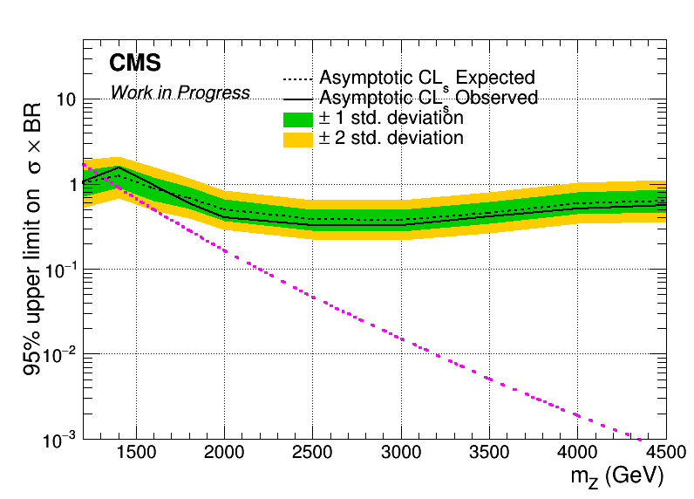
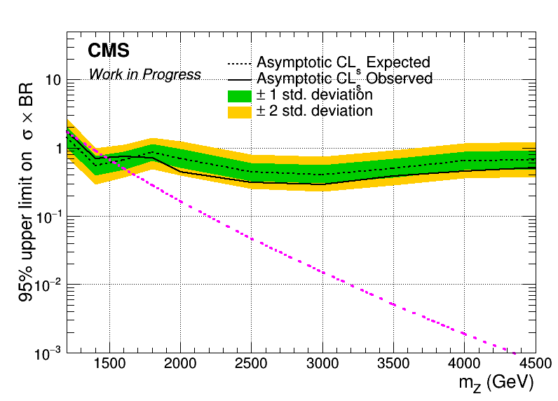
Brazilian Plots (2017)
mJJ > 1000 GeV
mJJ > 1200 GeV

Slide 16
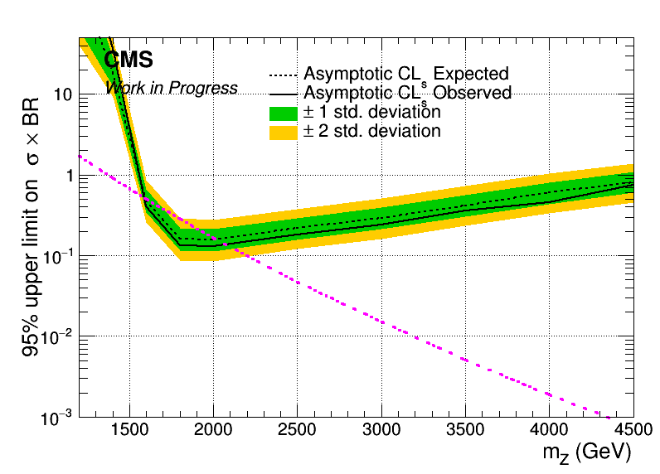
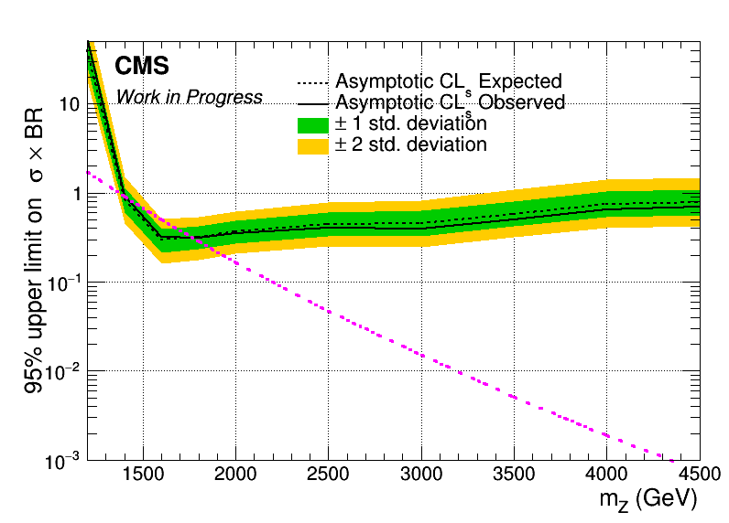

Asymptotic Limits - Brazilian Plots (2017)
mJJ > 1400 GeV
mJJ > 1600 GeV

Slide 17
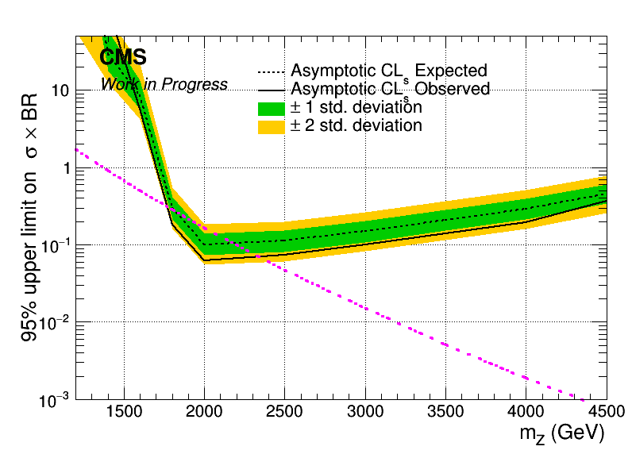
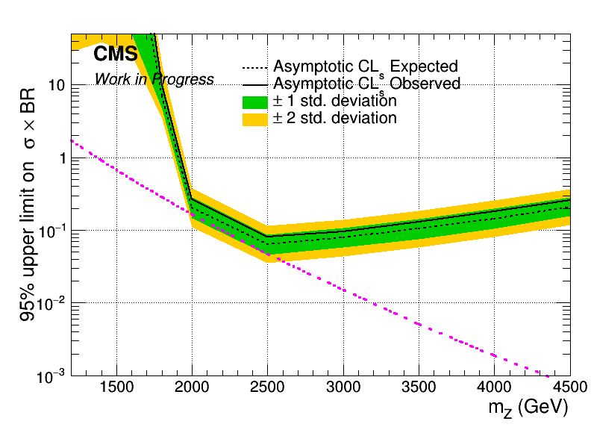
Brazilian Plots (2017)
mJJ > 1800 GeV
mJJ > 2000 GeV

